Slide 1

I/O Patterns
Dinesh & Rakesh
March 1, 2024

Slide 2
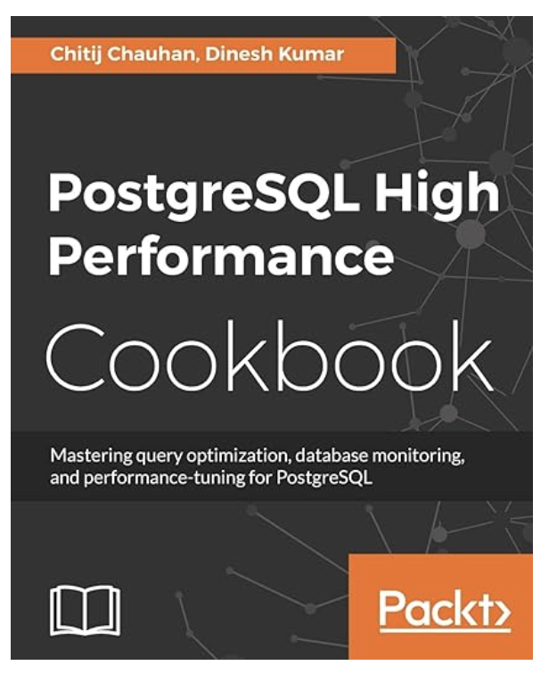

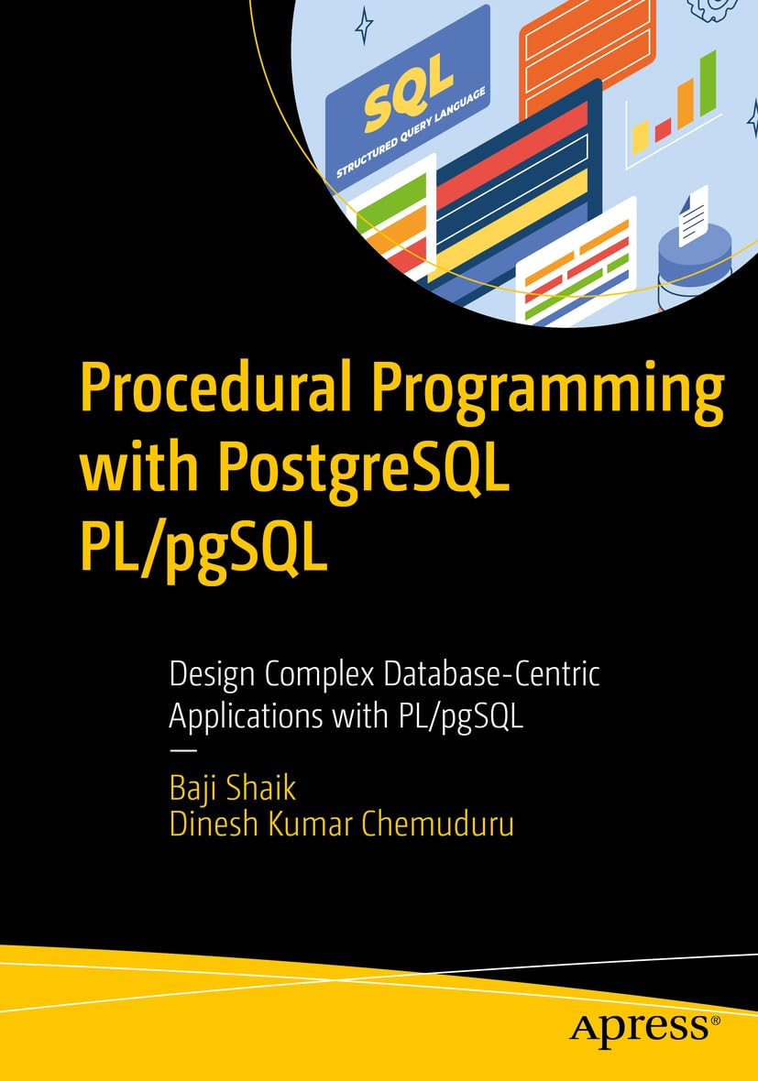

Dinesh Kumar
Principal Architect @ Tessell
Active contributor to Opensource tools around PostgreSQL
Author of two PostgreSQL books
Rakesh
Solutions Architect @ Tessell
Extensively built products & platforms with PostgreSQL

Slide 3


Tessell for PostgreSQL
2 PATENTS PENDING
High Performance databases on NVMe backed storage
Tessell Data Services
Nitro (i3en, i4i , Lsv3)
PERFORMANCE We’ve turned high performance compute into zero data loss data infrastructure
HIGH PERFORMANCE Compute Layer
NVMe
EBS
HIGH PERFORMANCE Local Storage
PERSISTENT EBS / Cloud Storage
FULLY AUTOMATED Snapshot Technology
DATA MANAGEMENT
$3.5B raised, ARR>$1B

Slide 4
What’s there
A quick premier on PostgreSQL I/O
Checkpoint
Background Writer
Vacuum/Autovacuum
Client Backend
Bulk Read/Writes
WAL I/O
Query I/O
Query Parallel Reads
Index I/O

Slide 5
What is I/O?
At a high level, an I/O operation is a request to either read data (”Input”) from or write data (”Output”) to a disk, typically measured in operations per second.

Slide 6
What is I/O?
Client Backend
Client Backend
PostgreSQL
Shared buffers
Kernel/OS
OS Cache
IOPS
Disk Cache
Hardware
Physical Storage

Slide 7
I/O Patterns
PostgreSQL uses a combination of memory components and background processes to manage its data storage and retrieval.
Memory
Shared_buffers
Wal_buffers
Work_mem
Maintenance_work_mem
Autovacuum_work_mem
Logical decoding_work_mem
temp_buffers
Processors
Backend client
Wal writer
Checkpointer
Backend client
Maintenance workers (Parallel)
Autovacuum workers
Wal senders

Slide 8
Memory & Processors
Memory
shared_buffers - is the memory space used by PostgreSQL for caching data blocks.
wal_buffers - is the buffer area used for caching write-ahead log information in PostgreSQL
work_mem - is the area for sort, hash_tables
maintenance_work_mem - is the area for maintenance operations like create index, vacuum
autovacuum_work_mem - is the area for autovacuum worker processor
logical_decoding_work_mem - is the area for walsender or replication connection, which converts WAL to logical stream
temp_buffers - is the area for, where temporary objects get created
Processors
client backend - interacts extensively with shared_buffers, wal_buffers, temp_buffers, work_mem
Checkpointer - interacts with shared_buffers, wal_buffers
wal writer - interacts with wal_buffers
maintenance workers - interacts with maintenance_work_mem
autovacuum workers - interacts with autovacuum_work_mem
walsenders - interacts with logical_decoding_work_mem

Slide 9
I/O Patterns
A simple PostgreSQL primary and replica instances are configured, to identify the I/O patterns in the PostgreSQL engine.
We used extensively 1. strace
2. Postgresql IO catalog tables
3. PostgreSQL logging to understand how the I/O is moving across the user operations.

Slide 10
I/O Pattern
Single DML
shared_buffers
Here, client backend connection doing a trivial WAL I/O after completing the trx. Updating the transaction commit/rollback status.
1. Into pg_wal file
2. Relation_fsm (freespacemap)
Single DML
Client Backend
wal_buffers
Wal Writer
WAL I/O
commit
synchronous_commit=on

Slide 11
I/O Pattern
Bulk Insert
shared_buffers
Client Backend
Here, client backend connection + wal writer
1. Into pg_wal file
2. Switch WAL
2. Relation_fm (FreeMap)
Bulk Insert
wal_buffers
Wal Writer
WAL I/O
commit
synchronous_commit=on

Slide 12
I/O Pattern
Bulk Insert
shared_buffers
fill
Client Backend
Here, client backend connection + wal writer
1. Into pg_wal file
2. Switch WAL
2. Relation_fm (FreeMap)
Bulk Insert
wal_buffers
Wal Writer
WAL I/O
commit
synchronous_commit=on

Slide 13
I/O Pattern
Any DML
shared_buffers
Here, wal writer will be doing the complete IO. 1. Into pg_wal
2. Do switching new wal
Any DML
Client Backend
wal_buffers
commit
Wal Writer
Here, all WAL I/O is delegated to WalWriter.
WAL I/O
synchronous_commit=off

Slide 14
I/O Pattern
Any DML
shared_buffers
(Full)
Relation I/O
Any DML
Client Backend
Here, client backend connection is doing more IO
1. Flush dirty buffers to underlying relation
2. WAL I/O
wal_buffers
Wal Writer
commit
WAL I/O
synchronous_commit=on

Slide 15
I/O Pattern
Temp Table
Client backend deals with the temp relation file. No WAL data, so no replication as well.
Temp tables are scoped to transaction, that is temp relations can be dropped after the COMMIT. No other I/O like autovacuum, checkpointer because temp tables are not a regular tables, and they reside in a special schema.
NO shared_buffers
TEMP TABLE
Client Backend
NO wal_buffers
temp_buffers
Relation I/O

Slide 16
I/O Pattern
Query
shared_buffers
Relation I/O
SQL Query
Client Backend
Client backends, and background parallel worker processes create temp files, it don’t find enough work_mem
work_mem
Not enough work_mem
Temp Tablespace I/O
pg_stat_database helps in identifying the I/O

Slide 17
I/O Pattern
Maintenance
maintenance_workers
maintenance_work_mem
Relation 1 I/O Relation 2 I/O
Maintenance
VACUUM REINDEX
1. Clears dead tuples
2. Do TRX freeze
3. Update vm
4. Update fsm
wal_buffers
Pg_stat_user_tables, Pg_stat_progress_vacuum Above two tables help in understanding vacuum behavior
Wal writer
WAL I/O

Slide 18
I/O Pattern
Background Write
Background writer gives relaxation to the client backends and checkpointer process. This periodically cleans the dirty buffers based on LRU.
Background Writer
shared_buffers
Schedule
Pg_stat_bgwriter is the catalog table, which helps in identifying the I/O
Relation1 I/O Relation2 I/O

Slide 19
I/O Pattern
Background Write
shared_buffers (FULL)
Relation I/O
Bulk DML
Client Backend
Background Writer
Relation1 I/O Relation2 I/O
wal_buffers
commit
Wal Writer
WAL I/O
synchronous_commit=on

Slide 20
I/O Pattern
Background Write
shared_buffers (FULL)
Relation I/O
Bulk DML
Client Backend
Background Writer
Relation1 I/O Relation2 I/O
wal_buffers
commit
Wal Writer
WAL I/O
synchronous_commit=on

Slide 21
I/O Pattern
Checkpointer
Dirty buffers
shared_buffers
Relation 1
Relation 2
Maintenance
checkpointer
Pg_stat_bgwriter is the table, helps in identifying the IO
wal_buffers
Disk page to WAL during the first modification of that page after a checkpoint.
Wal writer
WAL Cleanup
WAL I/O
full_page_writes

Slide 22
I/O Pattern
Walsender
logical_decoding_work_mem
Spill bytes to disk
Logical Replication Slot
walsender
If not enough memory, then data will spill into the disk. pg_stat_replication_slots is the catalog table, which helps in identifying the spill bytes. Balance this I/O from replica from PG 16 onwards.
Read Relation1 Read Relation2
Walsender COPY
Read WAL
Walsender START_REPLICATION

Slide 23
I/O Pattern
Logger
1. Database system activity
2. Autovacuum stats
3. Checkpointer stats
4. Wait locks, dead locks
5. Log rotation
6. Slow running queries
7. Queries generating many temp files
8.CSV/JSON log formats
Logical Replication Slot
Database System Logs
logger
logging_collector

Slide 24
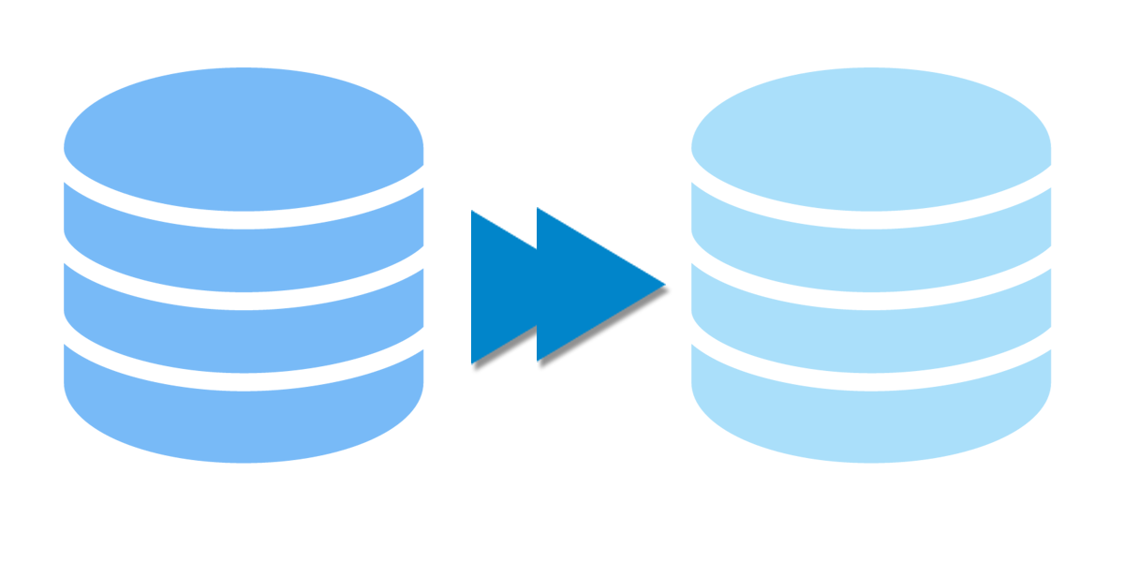
I/O Pattern
Replica
The background processes on a standalone replica instance is
checkpointer
bgwriter
startup recovering
walreceiver streaming
logger

Slide 25
I/O Pattern
Replica
Streaming Replication
walreceiver
wal_buffers
1. Received stream of changes from walsender, will be pushed to wal_buffers and WAL files.
2. There is no walwriter process in replica, the walreceiver process takes the role of creating WAL files
WAL I/O

Slide 26
I/O Pattern
Replica
shared_buffers
Relation 1 Relation 2
Streaming Replication
checkpointer
1. On replica, checkpoints are called restart points.
2. Only timed restart points, flush the data from shared_buffers to the underlying relation tables.
3. These restart points helpful to resume the interrupted recoveries.
WAL I/O Wal rotation

Slide 27
I/O Pattern
After the restart point completes, the dirty buffers from the replica shared_buffers got cleared.
Replica
postgres=# select count(*) from pg_buffercache where isdirty is true;
count
-------
312
(1 row)
postgres=# SELECT pg_is_in_recovery();
pg_is_in_recovery
-------------------
t
(1 row)
postgres=# CHECKPOINT ;
CHECKPOINT
postgres=# select count(*) from pg_buffercache where isdirty is true;
count
-------
312
(1 row)
2024-02-25 20:02:58.110 GMT [150861] LOG: restartpoint complete: wrote 49513 buffers (37.8%); 0 WAL file(s) added, 1 removed, 20 recycled; write=53.971 s, sync=0.004 s, total=54.053 s; sync files=15, longest=0.002 s, average=0.001 s; distance=347850 kB, estimate=347850 kB; lsn=8/400000C8, redo lsn=8/274F4E30
postgres=# select count(*) from pg_buffercache where isdirty is true;
count
-------
0
(1 row)

Slide 28
Thank You!

